Slide 1
Don’t worry be healthy
An estimated 34.2 million people have diabetes (10.5 percent of the U.S. population). Diagnosed: An estimated 26.9 million people of all ages have been diagnosed with diabetes (8.2 percent of the U.S. population).

Slide 2
About project - don’t worry be healthy :)
This app will contain useful information on people who have
-diabetes
-kidney disease
-liver disease
-heart disease
- people who want to improve their overall health

Slide 3
My plan:
Is to make an app that can help people feel better mentally + physically and help people be at their best health and thourougly research all of my informatio so that i made sure its correct for people who will use my app

Slide 4
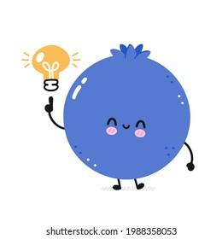
Some functions the app will include :
A notification feature that will remind you to drink water, eat something, and smile! The app will also include healthy exercises and recipes for people who are struggling with certain health issues.

Slide 5
I want to help everyone achieve their best health and become the happiest version of themselves

